Slide 1
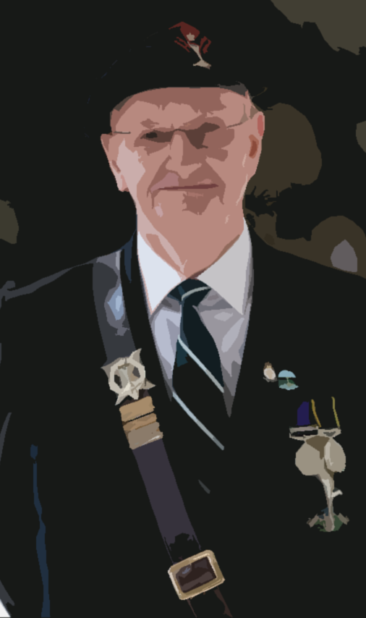
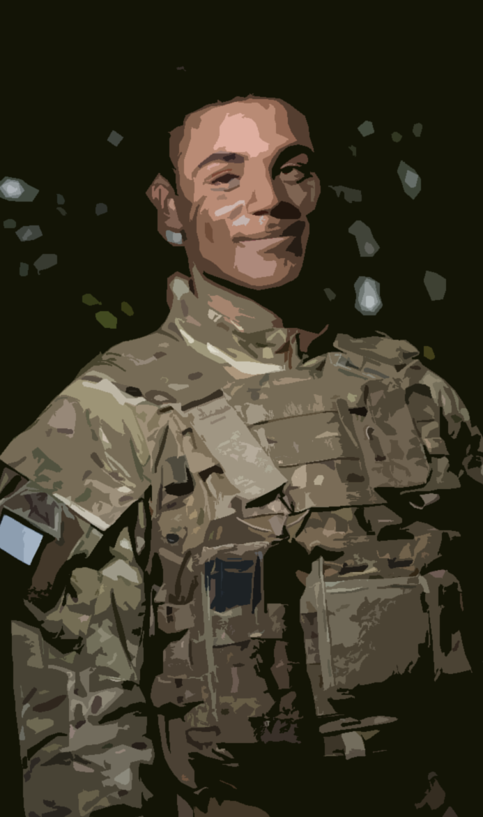
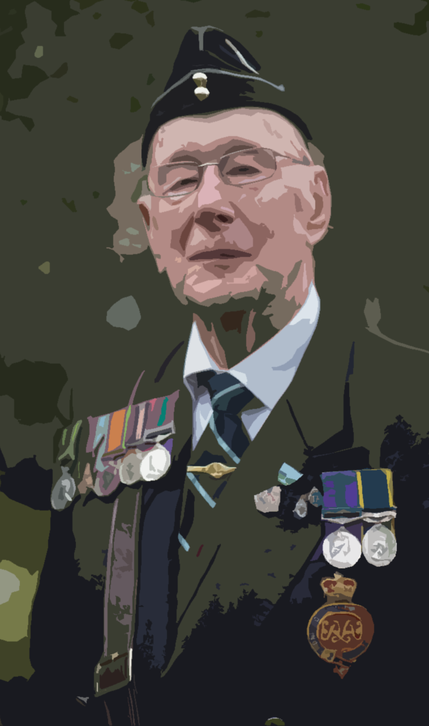



Slide 2

INTRODUCTION
Meet the team

Slide 3
AGENDA – ‘start the discussion’
Points from the General Secretary.
Points from the Assistant General Secretary.
Administrative Officer’s Report.
Corps Update – Forecast of Key Events
Questions…

Slide 4
General Secretary’s Update
The Royal Signals Charity:
  Strategic Review
  Financial implications
RSA Engagement:
  Membership
    Fees
    Cards
  Key appointments – reduced bureaucracy
The ‘new’ Corps website.
What next - how do we develop the Association?

Slide 5
Assistant General Secretary’s Update
Benevolence Update
Corps Weekend – What is it you would like to see?
  Meet and Greet
  Princess Royal Day Parade
  Band / Pipes and Drums?????
  What the serving Corps are doing???
  Vintage stuff????
  Bar’s, Eateries????
  Museum????
Modernisation of Events

Slide 6
Administrative Officer’s Update
Engagement with Corps HQ
Admin Assistant
Death notifications

Slide 7
Key Corps Events
2022
3 Sep 22 Corps Memorial at the National Memorial Arboretum.
13 Oct 22 The Autumn CCM
10 Nov 22 Field of Remembrance.
13 Nov 22 Cenotaph Parade.
25 - 26 Nov 22 Project NOEL.
2023
17 Mar 22 The Spring CCM
18 Mar 22 AGM at The Victory Services Club.
21 May 23 Eden Camp.
16 - 18 Jun 23 Corps Weekend

Slide 8

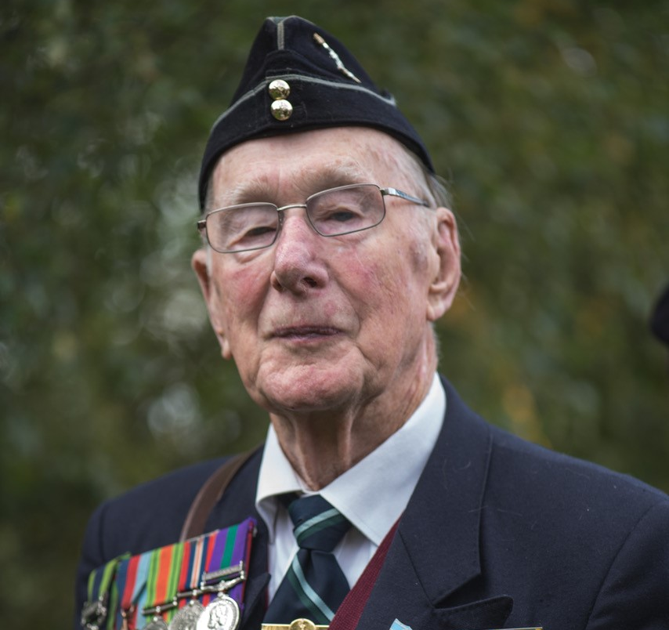
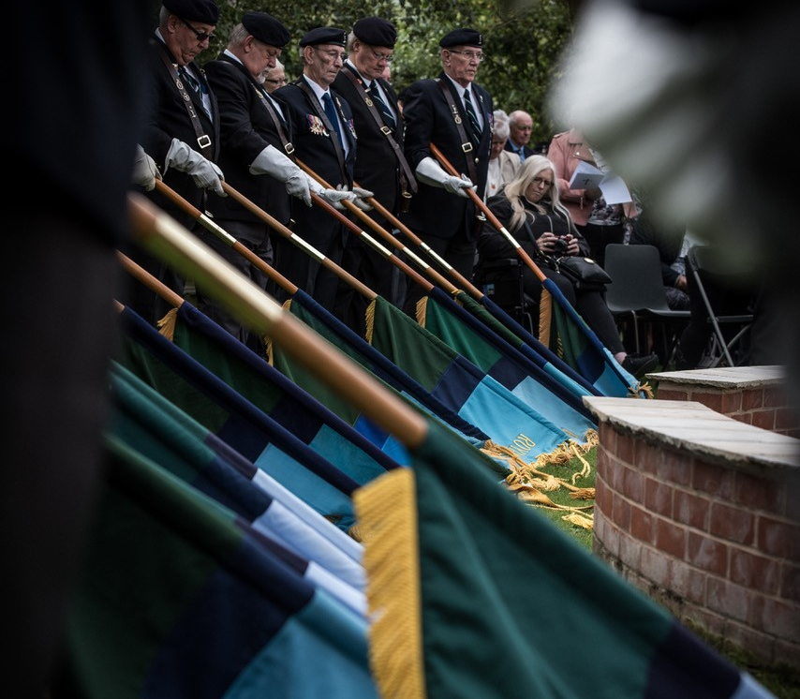
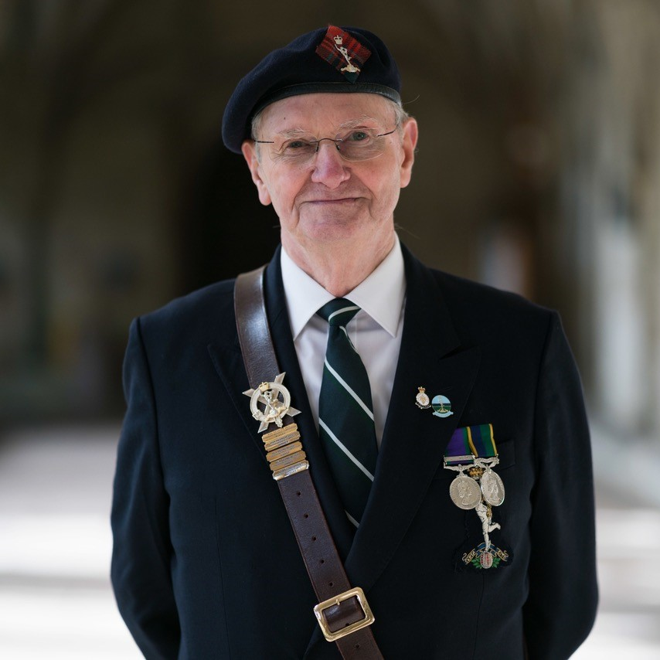
Q&A?

